Slide 1

Employee Attrition
Jacob Werschey

Slide 2


Why identify what causes attrition?
According to the 2014 Training Industry Report from Training magazine, the annual training budgets of U.S. small businesses totaled an average of $308,000 in 2014, with retail and wholesale spending more than half a million dollars. Approximately twelve hundred dollars was spent per employee. -Forbes
Besides the monetary costs of onboarding, there are time and productivity costs in supervisors and fellow employees bringing new hires up to speed on processes. New hires are more likely to make mistakes that manifest as monetary and/or time costs to fix.
By identifying the factors that cause employees to quit, we can devise cost effective strategies to retain employees by improving job related factors.
A predictive model could help us assess which employees are likely to quit and address produce a custom data driven strategy for those employees (more training, improving satisfaction, etc.)

Slide 3
Exploring The Data
Education, Environment, Role Involvement, Role Satisfaction, Performance, Relationship, Work Life Balance, Stock Options
Rating features: Higher is better / more advanced (Higher education, better relationship with coworkers, stock options)
Education Field, Department, JobRole, Martial Status, Overtime, Gender
Text features: Job title, Yes/No, Male/Female
Hourly rate, Daily rate, Monthly rate, Monthly Income
Monetary Variables
Total Working, At Company, Since Last Promotion, In Current Role, With Current Manager
Work experience features: Counted in years
Age, TrainingTimesLastYear, Number of Companies worked
Other numeric variables

Slide 4
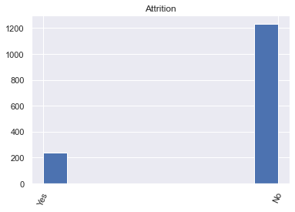
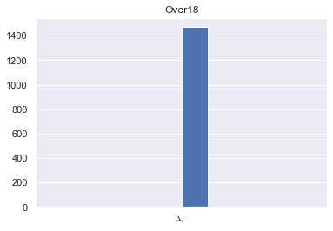
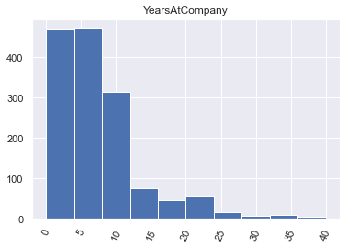
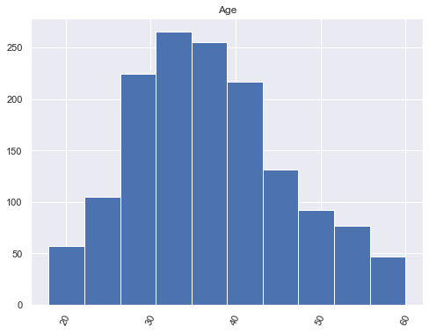
Simple Analysis
The dataset is imbalanced with about only 16% of the employees having quit. All employees are over 18 and most have been working here 10 years or less.

Slide 5
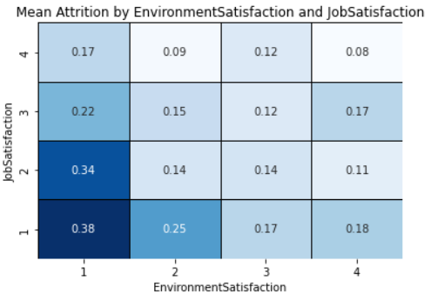
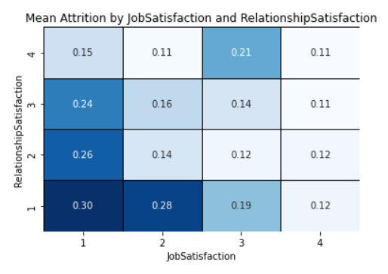
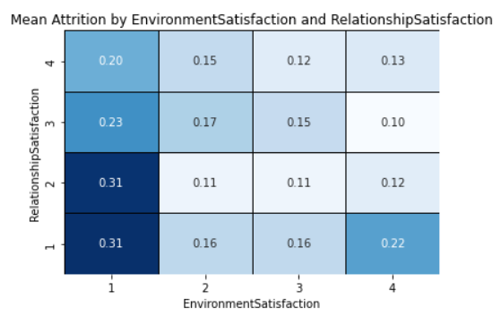
Satisfaction and Attrition
Most employees are/were satisfied with their roles, environment, relationships
Poor satisfaction in any category heavily effects attrition unless the employee is very satisfied in others
Oddly, a job score for 3 and a relationship score for 4 has higher attrition rates than all adjacent cells

Slide 6
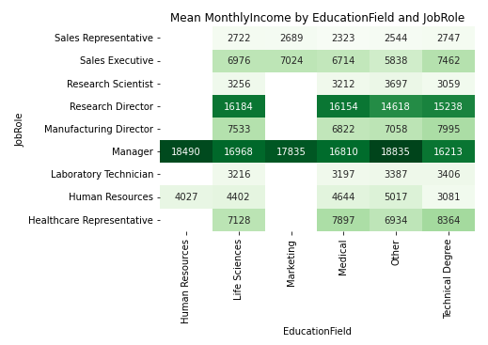
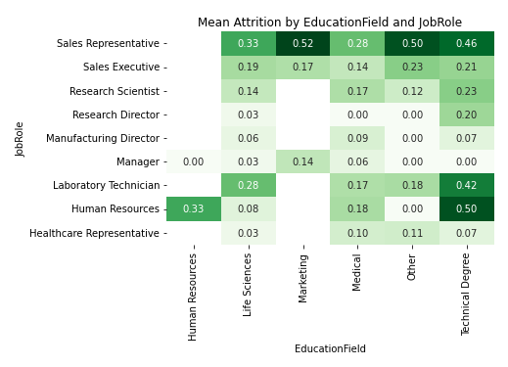
Education & Pay Vs Role
Sales Roles have high attrition
Roles that align with the field of study are surprisingly high. Do employees get bored?
Managers and Directors make more than their counterparts and experience less attrition

Slide 7
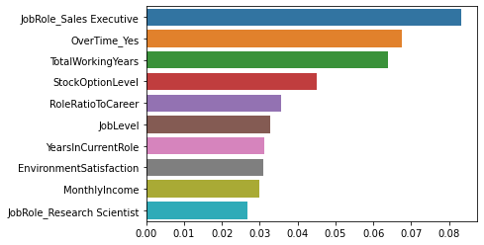
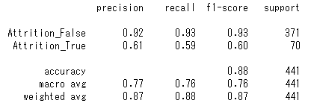
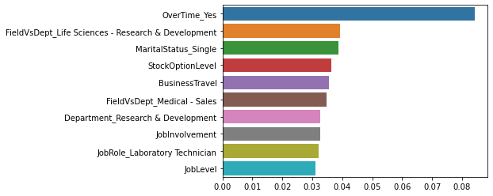
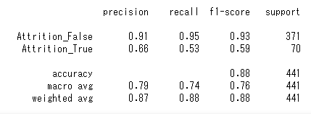
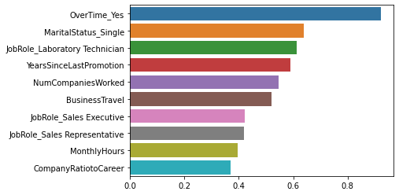
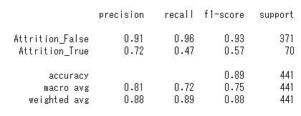
Modeling Overview
XGBOOST W/ SMOTE
XGBOOST, Logistic Regression, Random Forest, and K Nearest Neighbors were tried with 5-fold Cross validation.
F1 Score was chosen as the target parameter for detecting the minority class (Attrition_True)
XGBOOST performed best overall with and without synthetic data.
All models returned Overtime and Stock Option Levels as important features. Spending more time in the same role or company as a ratio of career were predictors, as were certain job roles – notably Sales and Technicians.
2 of 3 models returned Marital status as results
XGBOOST W/O SMOTE
LOGISTIC REGRESSION

Slide 8
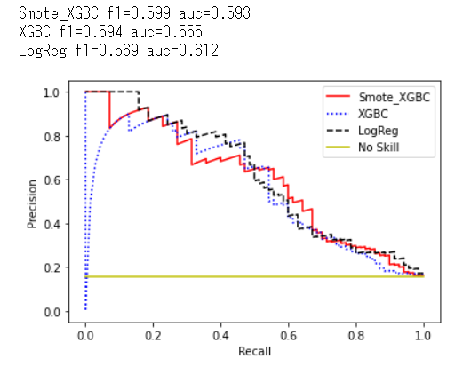
Modeling Overview
XGBOOST, Logistic Regression, Random Forest, and K Nearest Neighbors were tried with 5-fold Cross validation.
F1 Score was chosen as the target parameter for detecting the minority class (Attrition_True)
XGBOOST performed best overall with and without synthetic data.
All models returned Overtime and Stock Option Levels as important features. Spending more time in the same role or company as a ratio of career were predictors, as were certain job roles – notably Sales and Technicians.
2 of 3 models returned Marital status as results

Slide 9
XGBOOST TUNING
Grid search parameters
Parameters searched
Best parameters
Smote
No-smote
5-Fold cross validation
Random State: 42
Scored on F1
Learning Rate: .1 - 1
Max Depth: 3-7, None
Estimators: 60-180 by 20
.1
4
120
.5
3
60

Slide 10


Key Findings
Burnout is common among employees. Workout and staying in the same position too long are major factors of attrition.
Traditionally higher demanding roles (namely Technician and Sales) have higher attrition.

Slide 11
So, what do we do about it?
Stagnation in roles
HIGH attrition roles
Overtime
Better promotion / transfer opportunities
Cross training roles
Options for pay structures to alleviate stress for sales positions
Breaking up duties for technical positions
Alleviated by solving other major problems as a result of retaining employees

Slide 12

Thank you

